Slide 1
Weather Forecasting Application
Supervisor :Dr/Mohamed Abdallah
Software Engineering || CSE251

Slide 2
Name | ID | Program
Mena Mohamed Osman | 221100521 | CS
Shrouq Hisham Salman | 223108628 | AIS
Hajar Mohamed | 222200040 | AIS
Aser Mohamed Ali | 222102487 | AIS
Jomana Sami Adelaziz | 222100458 | CS

Slide 3
Table of contents
1
Introduction
4
SDLC
2
SRS
5
UML Diagrams
3
GUI
6
Conclusion and future work

Slide 4
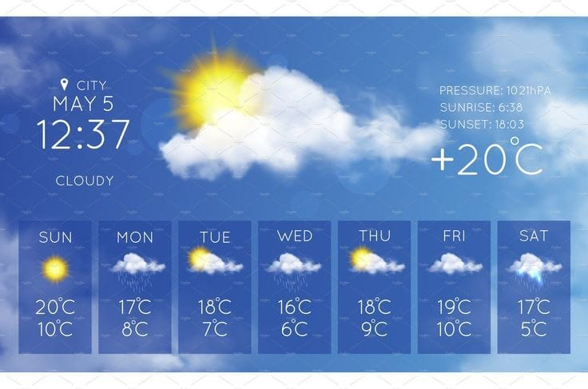
Introduction
Weather forecasting applications play a crucial role in providing accurate weather information to users. Whether you’re planning a trip, organizing an outdoor event, or simply curious about the weather, having a reliable weather app can make a significant difference. In this project, we’ll create a Todays Weather App, which will allow users to check the weather details for any location.

Slide 5
Software requirement specification (SRS)
The business problem that we have solved:
Weather conditions significantly impact our daily lives, from planning outdoor activities to making travel decisions. Having accurate and up-to-date weather information is essential for users worldwide. Our goal is to create a user-friendly Todays Weather App that provides real-time weather details for any location.
Key Challenges:
Data Retrieval: Fetching accurate weather data from reliable sources.
User Interface: Designing an intuitive and visually appealing interface.
Accuracy: Ensuring precise weather predictions based on available data.
Objectives:
User-Friendly Interface: Creating an easy-to-navigate app with a clean design and Display essential weather information (temperature, wind speed, humidity, etc.) for the user’s selected location.
Real-Time Data Integration: Connecting to external weather APIs and Retrieve current weather conditions for a given city or coordinates.
Accuracy and Reliability: Implementing algorithms to process weather data and Validate predictions against ground truth data.

Slide 6
Software requirement specification (SRS)
Proposed system:
Inserting the details : user and companies have to insert their details.
Updating the details: As time user and companies have to update their details.
User registration : Administrator permit user for registration, companies can also do registration.
Event Details: Administrator update the weather.
Recruitment Process: Every 3 hour updating weather.
Functional Requirements : New user requirements :
When user want to get advantage of this Application they have to first Register themselves by providing their details.
After completion of registration a User ID and Password will be provided to the user.
They can use that id and password for login to application and see the weather detail.
Searching : User can search company by:
Technology
Location
Software Interface:
• Programming Language: python ,HTML, css
• We used the API
Communication interface:
• This website supports all types of web browsers.
• User will be informed about placement process by uploading dashboard by administrator.
• Selected candidates will be informed for interview via mail by company.

Slide 7
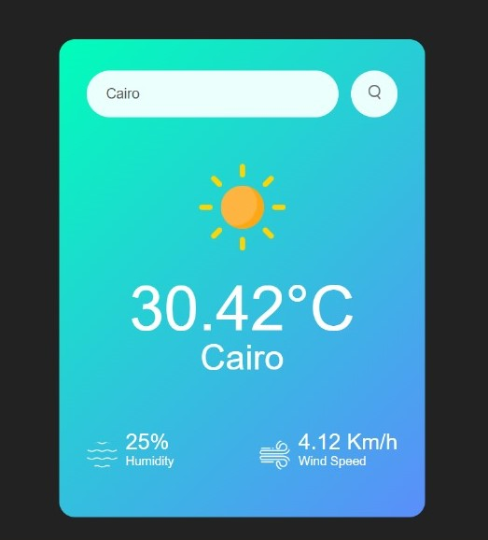
Graphical User Interface (GUI)
User Searches for Weather Forecast for a Specific City
User Action: The user enters the name of a city in the search bar.
System Response: The system sends a request to the OpenWeather API to retrieve weather data for the specified city.
System Response: The system receives the weather data from the OpenWeather API.
System Action: The system displays the current weather data and the 7-day weather forecast for the specified city, including daily temperature highs and lows, precipitation chances, and general conditions.
City
Label
Temperature
Humidity &
Wind speed

Slide 8
Software development lifecycle (SDLC)
The software development lifecycle (SDLC) outlines several tasks required to build a software application. The development process goes through several stages as developers add new features and fix bugs in the software.
We have made a five models to describe the software process:
Waterfall model: the waterfall model arranges all the phases sequentially so that each depends on the outcome of the previous phase.
2) Evolutionary model:
a.The Prototype Evolutionary model : proposes to create a small block of the system by gathering requirements.
b.The Agile model : consists of several frameworks like scrum that helps build complex products.
3) Spiral model: like evolutionary model, in addition to being compination of prototyping and waterfall.
4) Transformation model: this model is concerned with application of mathematical technique to implement the software.
5) V-Shape model: its verification(left) and validation(right) model & result of each phase of verification is used as input of validation process.

Slide 9
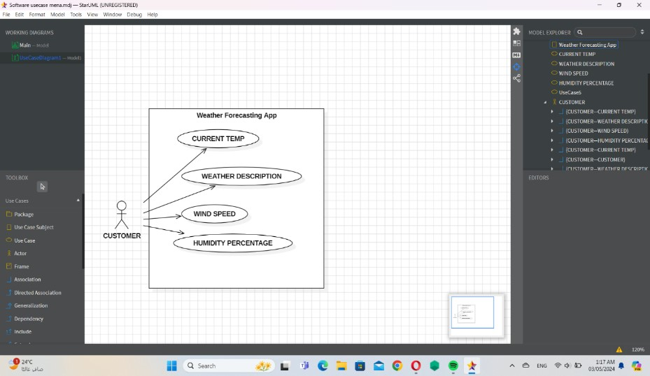
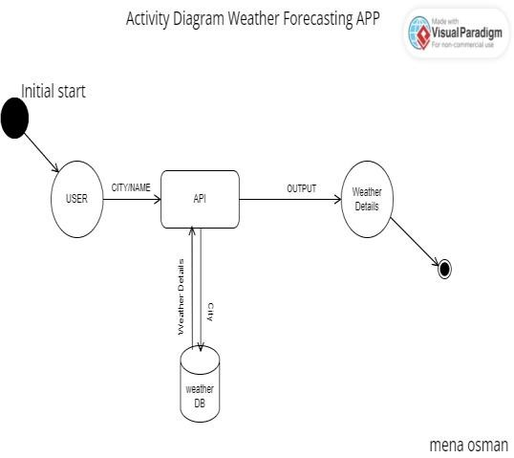
UML Diagrams
Use-Case diagram
Activity diagram
A use-case diagram illustrates user interactions and system. This activity diagram captures the sequence of actions and decisions involved in viewing weather data, providing a clear overview of the process flow.

Slide 10
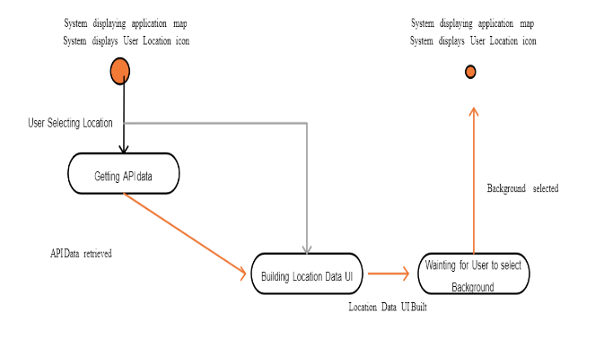
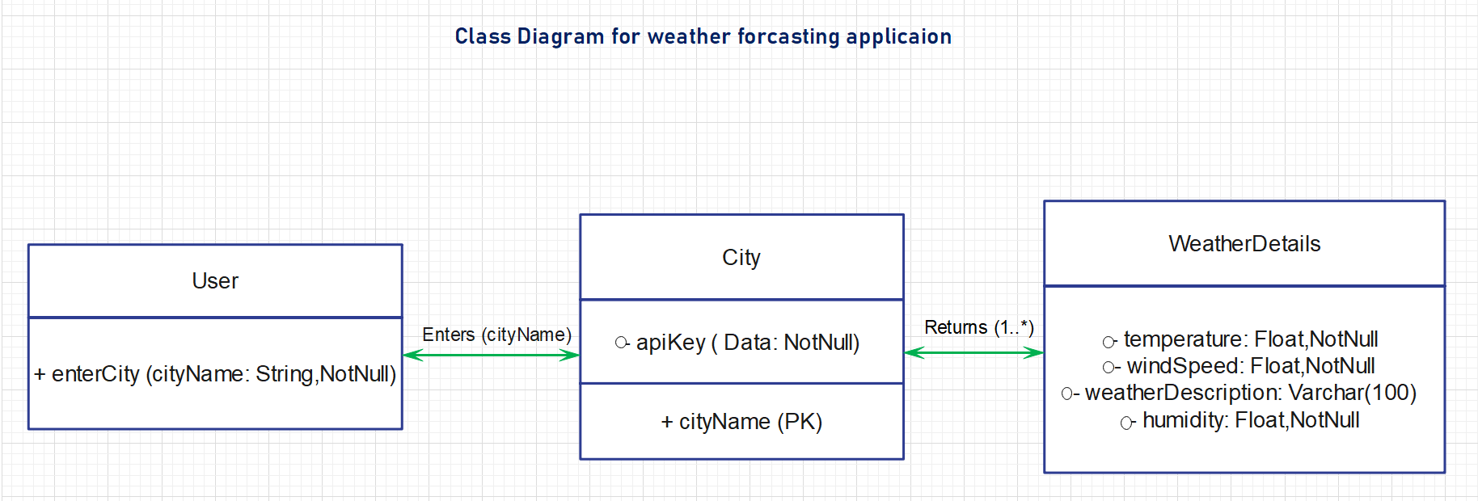
UML Diagrams
State diagram
Class diagram
while a class diagram models the system's static structure
state diagram depicts object states and transitions
including classes and their relationships

Slide 11
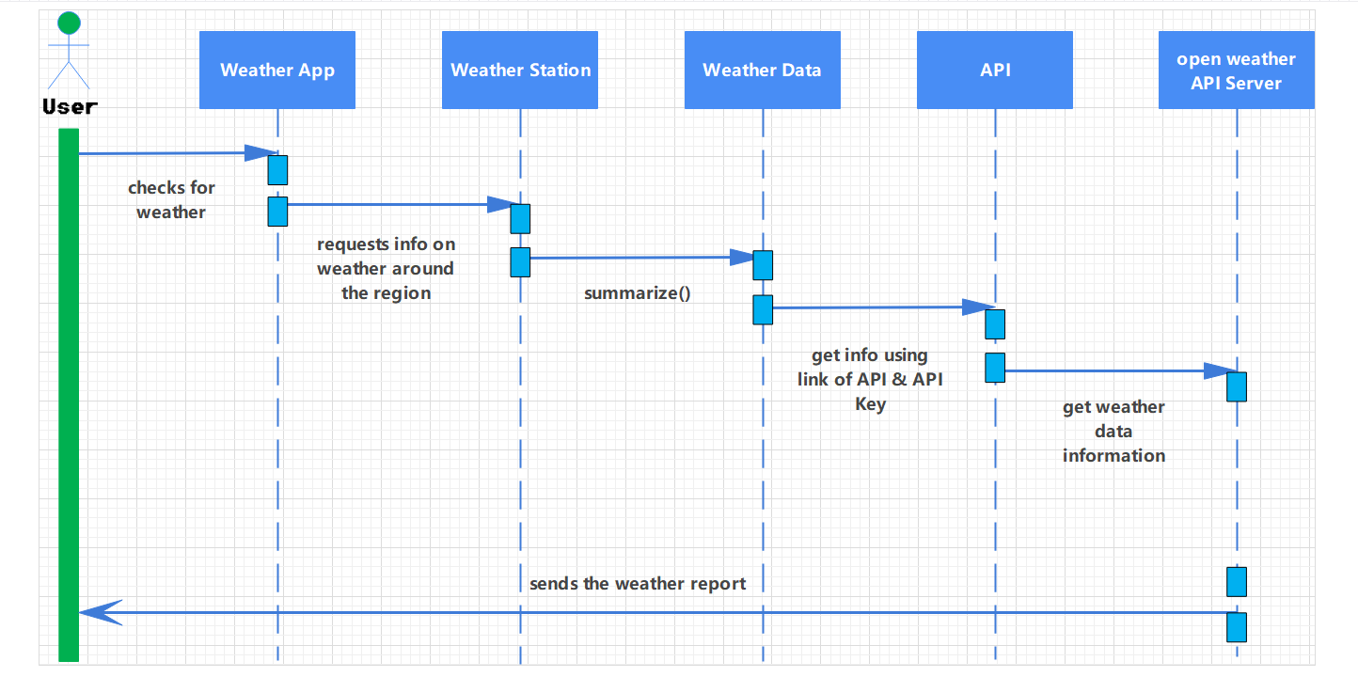
UML Diagrams : Secuence diagram:
sequence diagram shows the sequence of interactions between objects to accomplish specific tasks.

Slide 12
Conclusion and future work
Future enhancements while our initial Todays Weather App covers the basics, consider adding the following features:
Extended Forecasts: Provide weather predictions for upcoming days.
Location-Based Alerts: Notify users about severe weather conditions.
Customization Options: Allow users to personalize the app (e.g., preferred units).
Integration of future weather prediction using Machine learning technologies.
Integration of any natural disaster prediction in the location.
Integration of local time and international time in that location, we can add this using any api.
We can add top weather headlines in the nearby locations as well.
We can add last 10 days time line of weather forecasting of the selected location as well.

Slide 13
Thank you

